Slide 1
D-125
NIRWANA

Slide 2
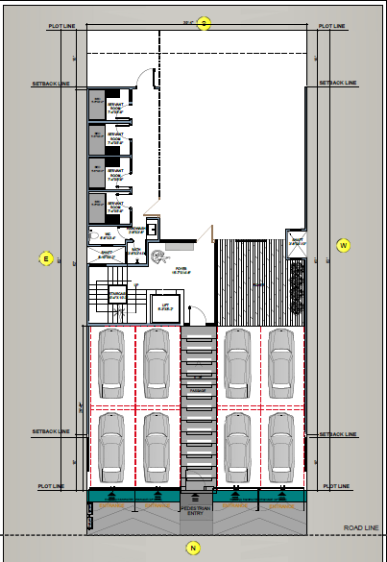

Slide 3
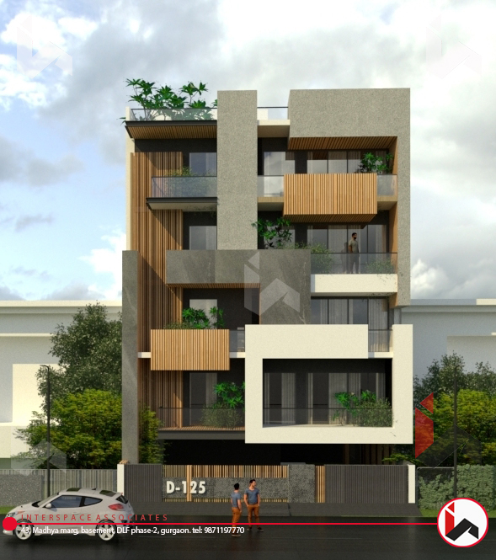

Slide 4
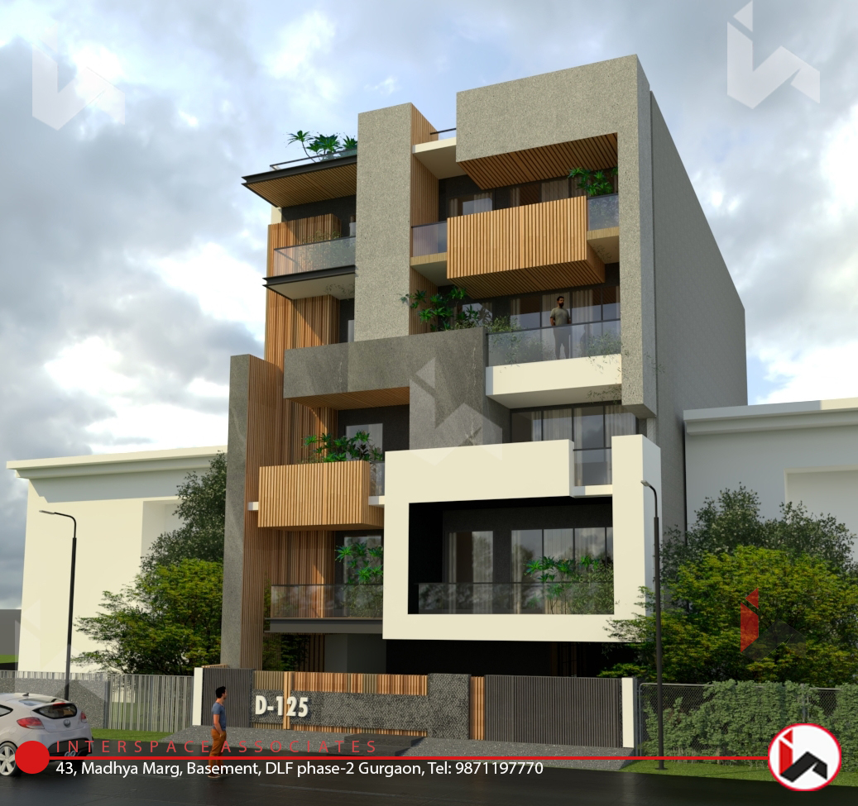

Slide 5
Disclaimer: **Show items of Furniture/Fittings etc are for indication only & are not included in the sale of property. **Because our products are under continuous development, elements of detail in images (materials, specifications etc) may be subject to change without notice.

Slide 6
Disclaimer: **Show items of Furniture/Fittings etc are for indication only & are not included in the sale of property. **Because our products are under continuous development, elements of detail in images (materials, specifications etc) may be subject to change without notice.

Slide 7
Disclaimer: **Show items of Furniture/Fittings etc are for indication only & are not included in the sale of property. **Because our products are under continuous development, elements of detail in images (materials, specifications etc) may be subject to change without notice.

Slide 8
Disclaimer: **Show items of Furniture/Fittings etc are for indication only & are not included in the sale of property. **Because our products are under continuous development, elements of detail in images (materials, specifications etc) may be subject to change without notice.

Slide 9
Disclaimer: **Show items of Furniture/Fittings etc are for indication only & are not included in the sale of property. **Because our products are under continuous development, elements of detail in images (materials, specifications etc) may be subject to change without notice.

Slide 10
Disclaimer: **Show items of Furniture/Fittings etc are for indication only & are not included in the sale of property. **Because our products are under continuous development, elements of detail in images (materials, specifications etc) may be subject to change without notice.

Slide 11
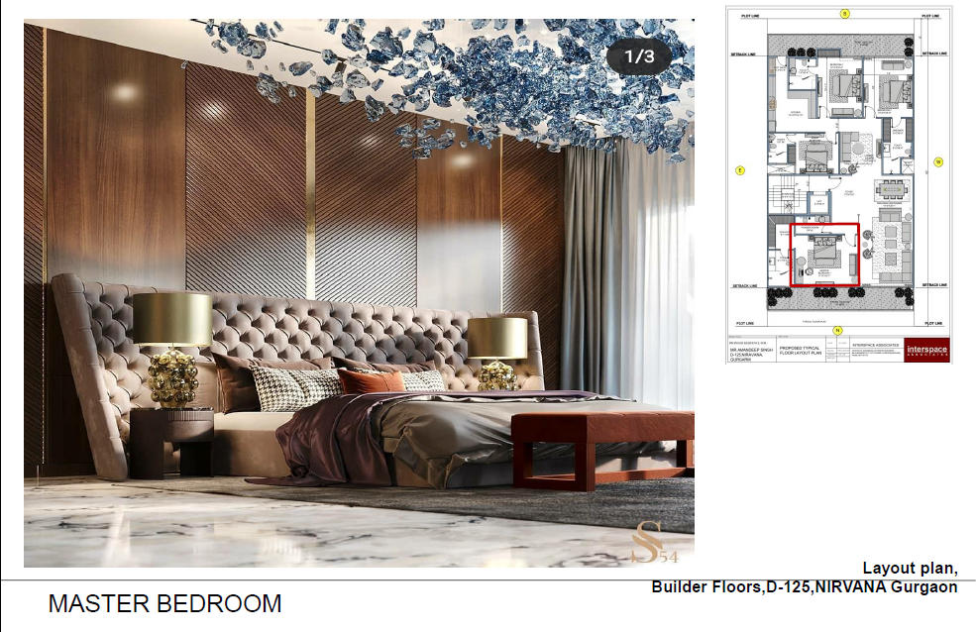
Disclaimer: **Show items of Furniture/Fittings etc are for indication only & are not included in the sale of property. **Because our products are under continuous development, elements of detail in images (materials, specifications etc) may be subject to change without notice.

Slide 12
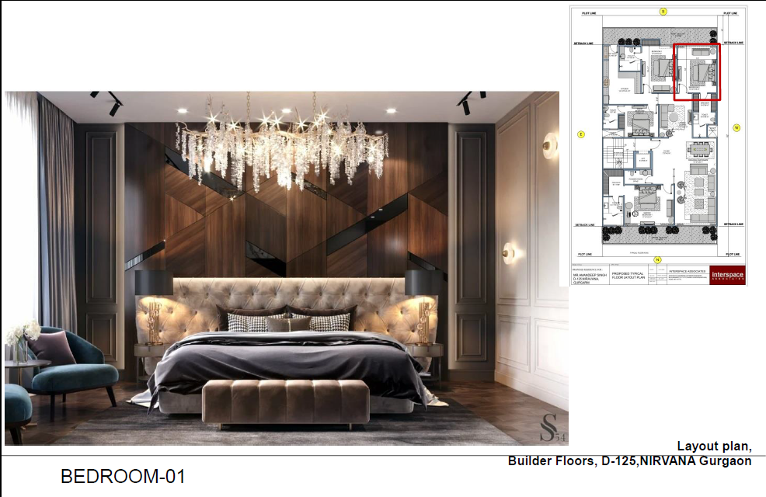
Disclaimer: **Show items of Furniture/Fittings etc are for indication only & are not included in the sale of property. **Because our products are under continuous development, elements of detail in images (materials, specifications etc) may be subject to change without notice.

Slide 13
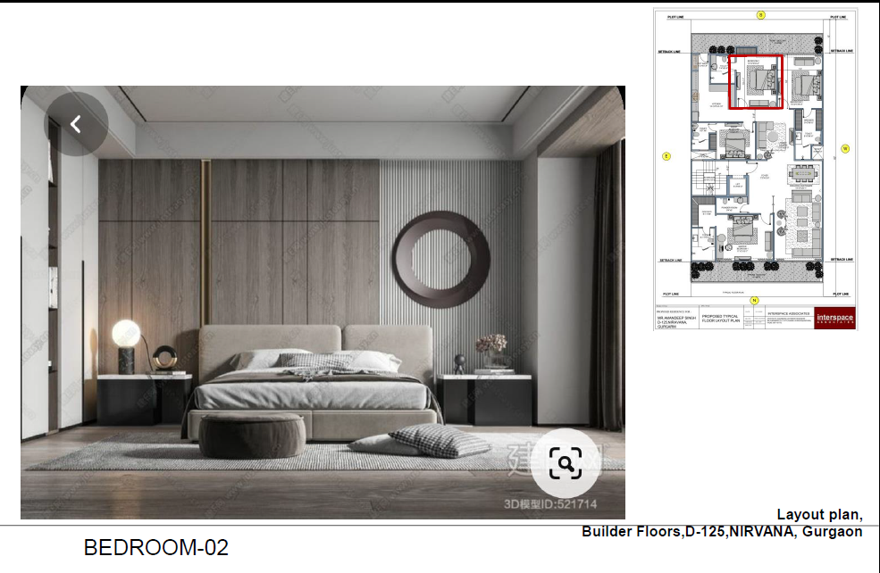
Disclaimer: **Show items of Furniture/Fittings etc are for indication only & are not included in the sale of property. **Because our products are under continuous development, elements of detail in images (materials, specifications etc) may be subject to change without notice.

Slide 14
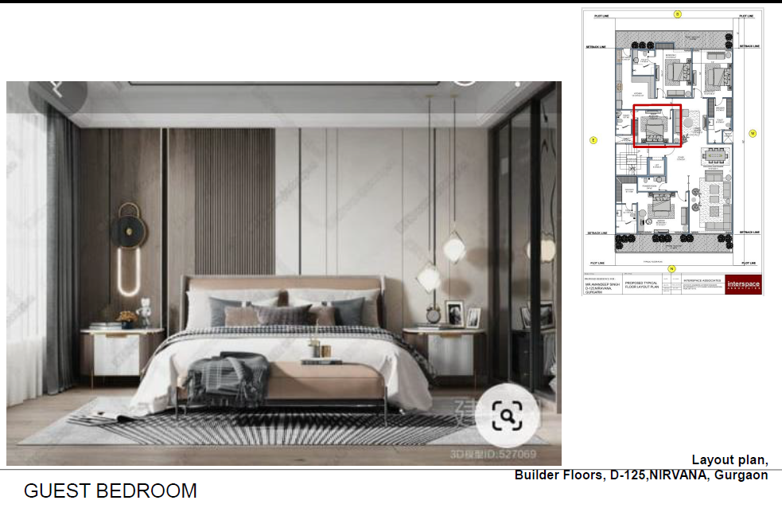
Disclaimer: **Show items of Furniture/Fittings etc are for indication only & are not included in the sale of property. **Because our products are under continuous development, elements of detail in images (materials, specifications etc) may be subject to change without notice.

